Slide 1
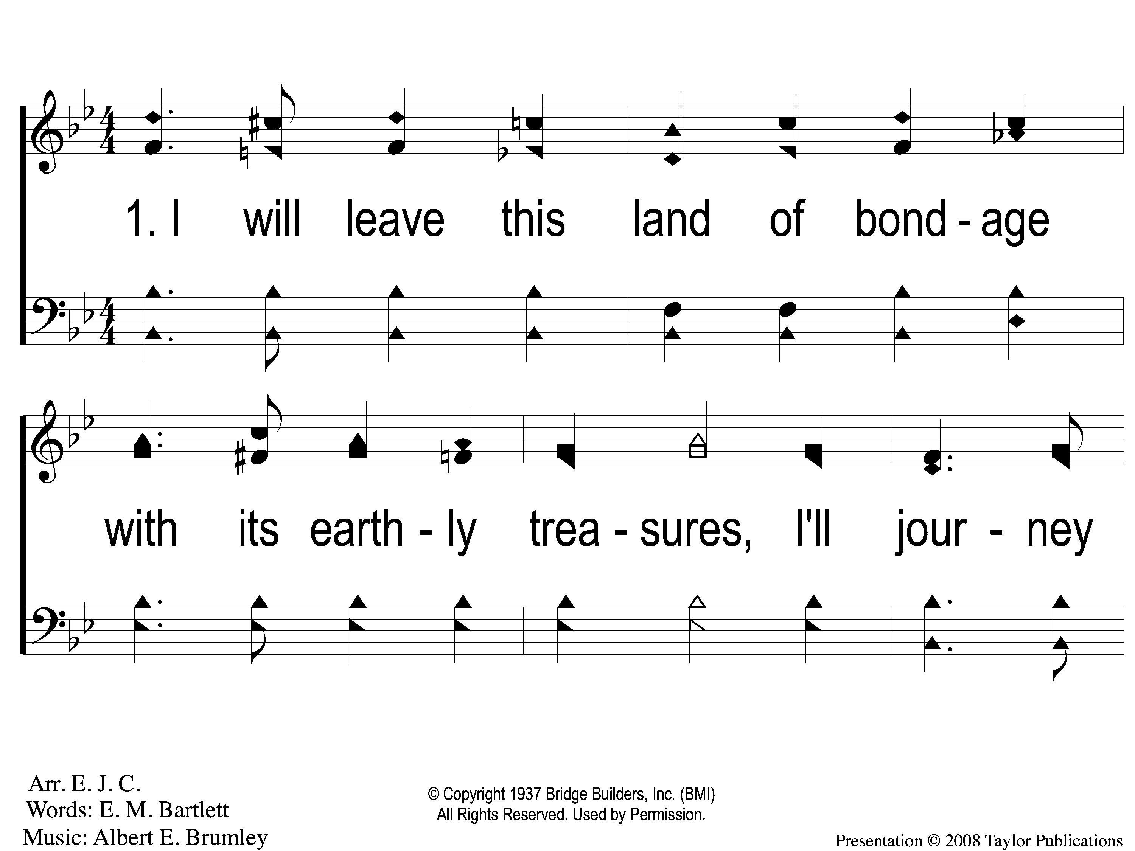
1-1 Camping Toward Canaan’s Land
Camping Toward Canaan’ Land
58

Slide 2
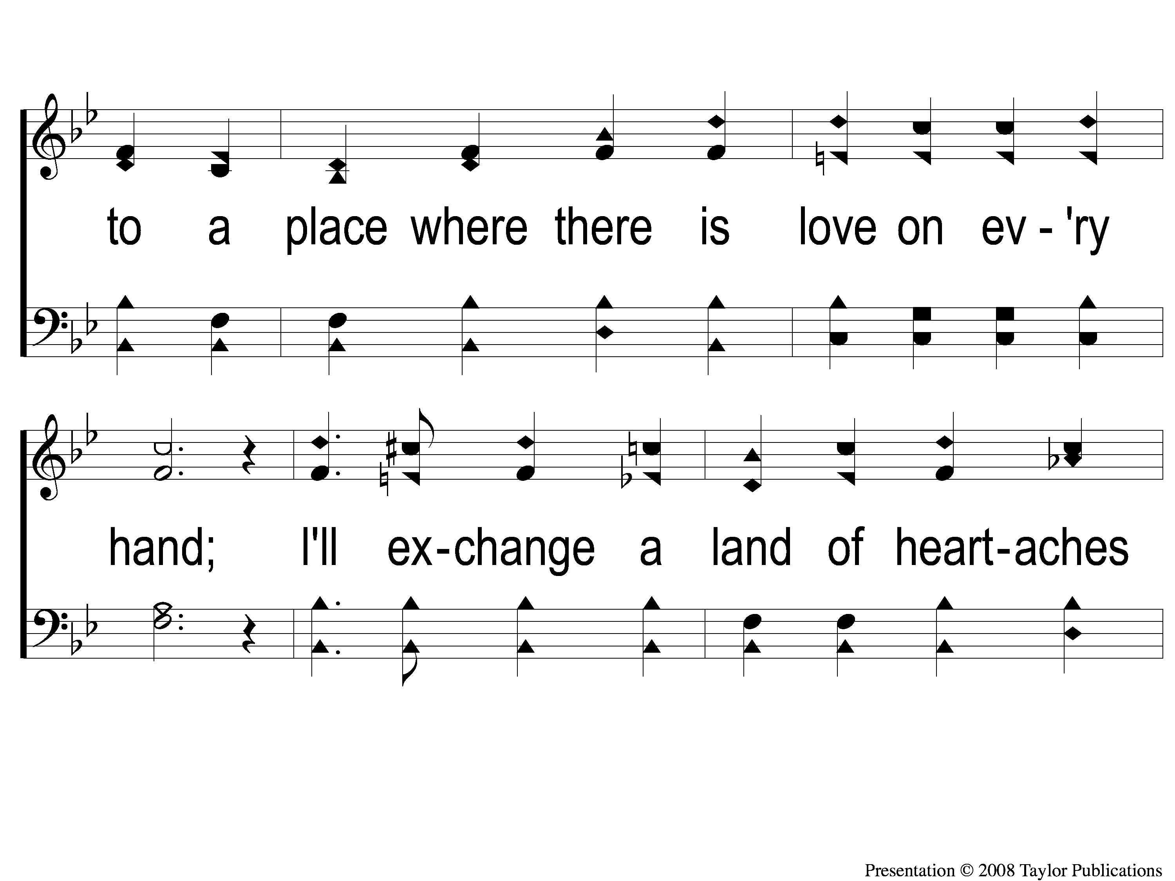
1-2 Camping Toward Canaan’s Land
Camping Toward Canaan’ Land
58

Slide 3
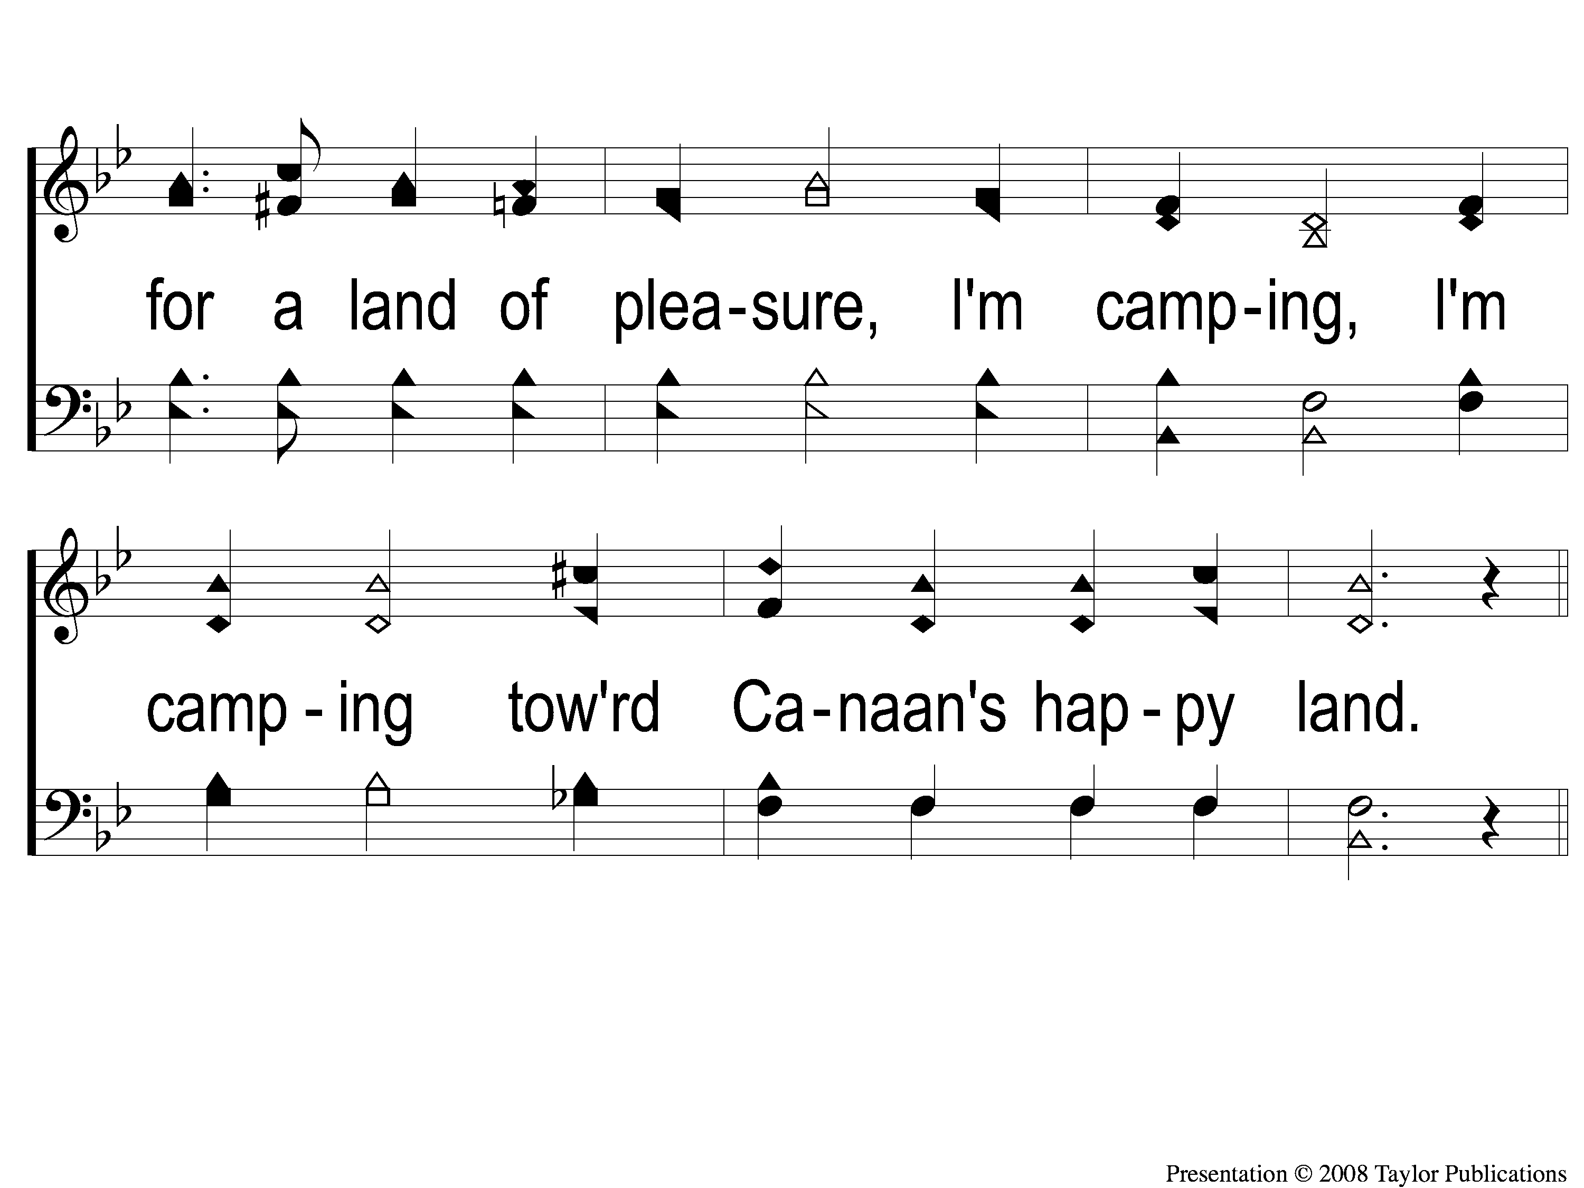
1-3 Camping Toward Canaan’s Land
Camping Toward Canaan’ Land
58

Slide 4
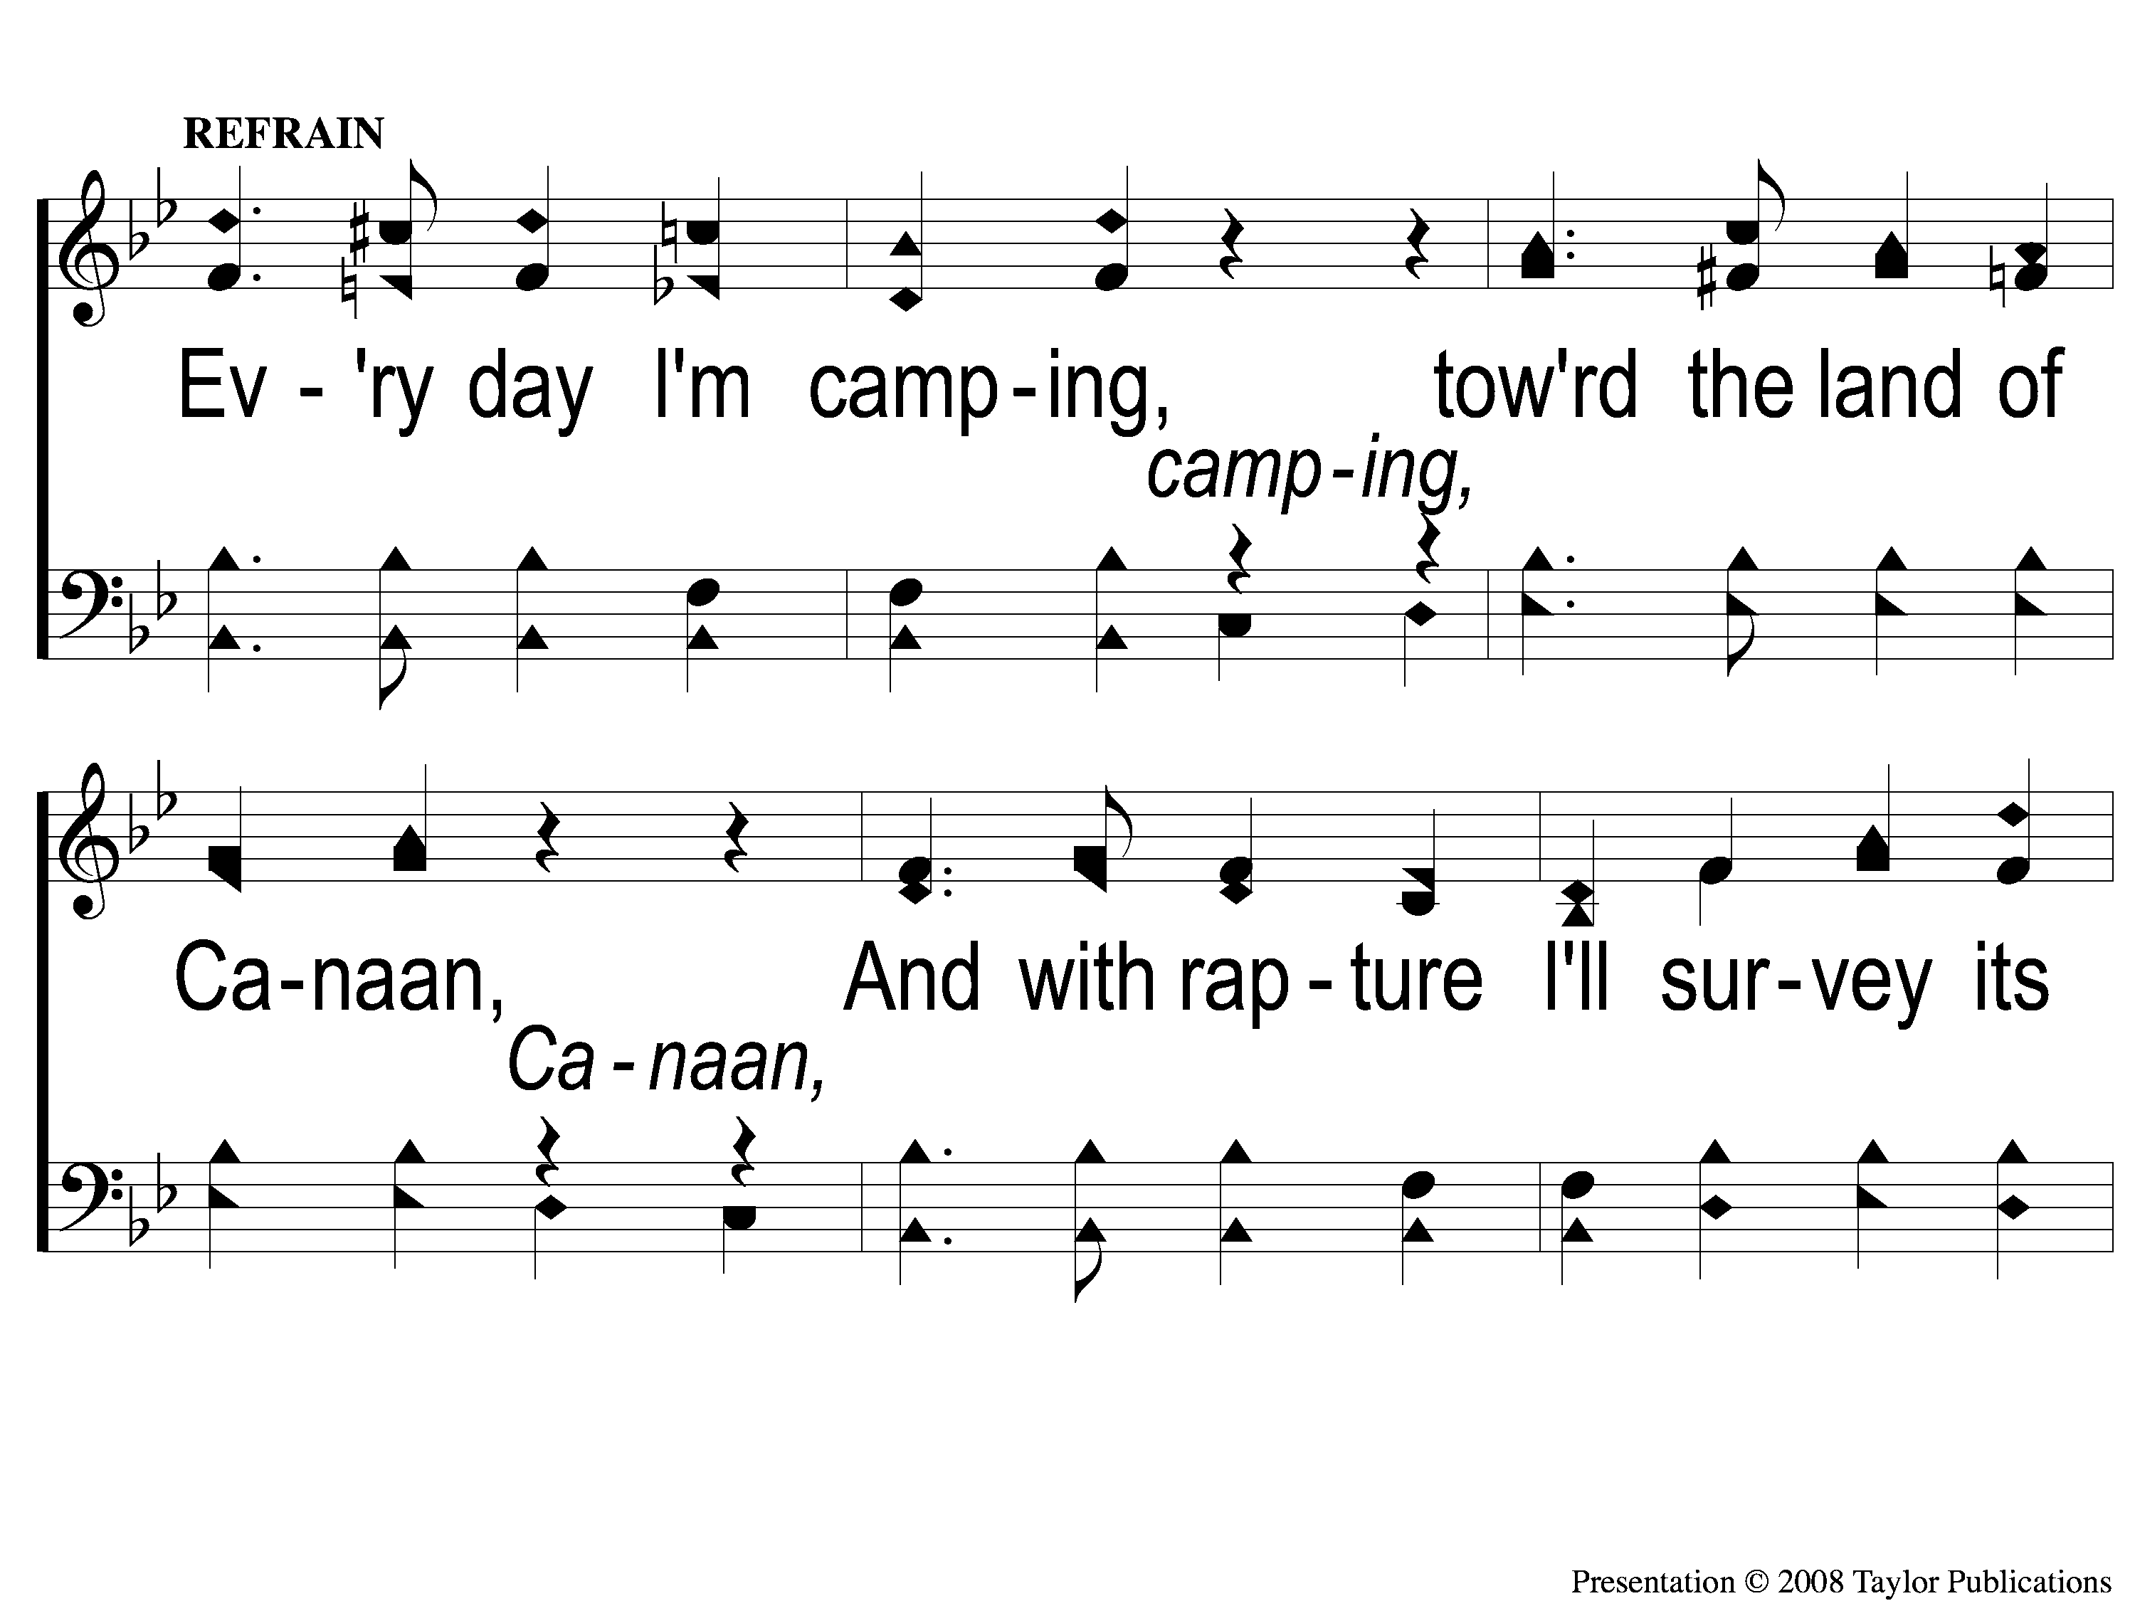
C-1 Camping Toward Canaan’s Land
Camping Toward Canaan’ Land
58

Slide 5
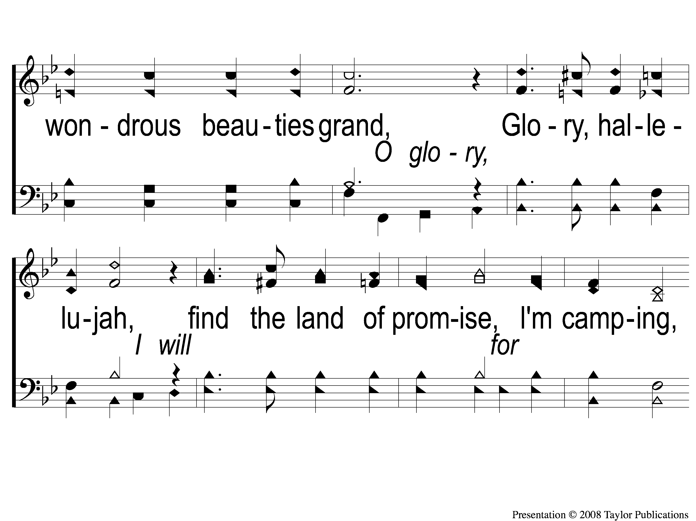
C-2 Camping Toward Canaan’s Land
Camping Toward Canaan’ Land
58

Slide 6
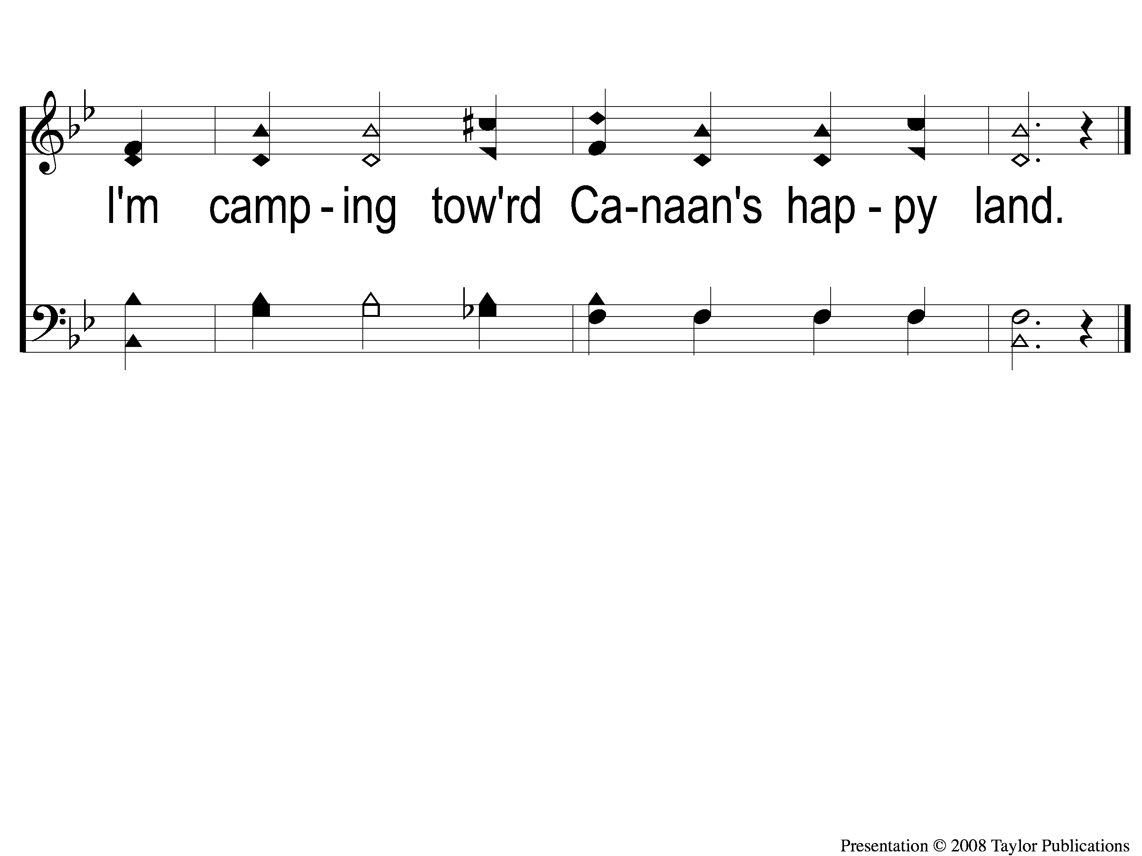
C-3 Camping Toward Canaan’s Land
Camping Toward Canaan’ Land
58

Slide 7
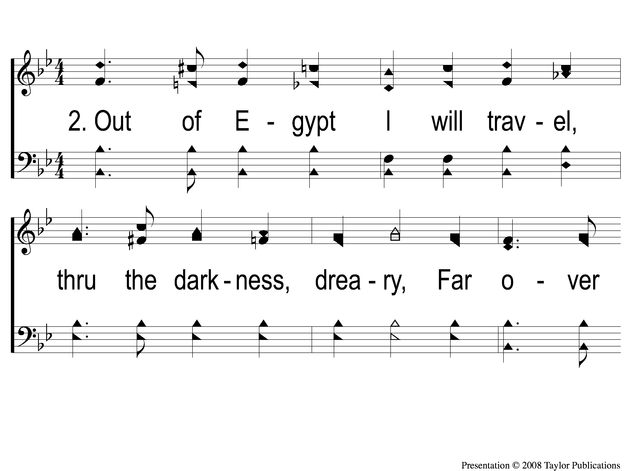
2-1 Camping Toward Canaan’s Land
Camping Toward Canaan’ Land
58

Slide 8
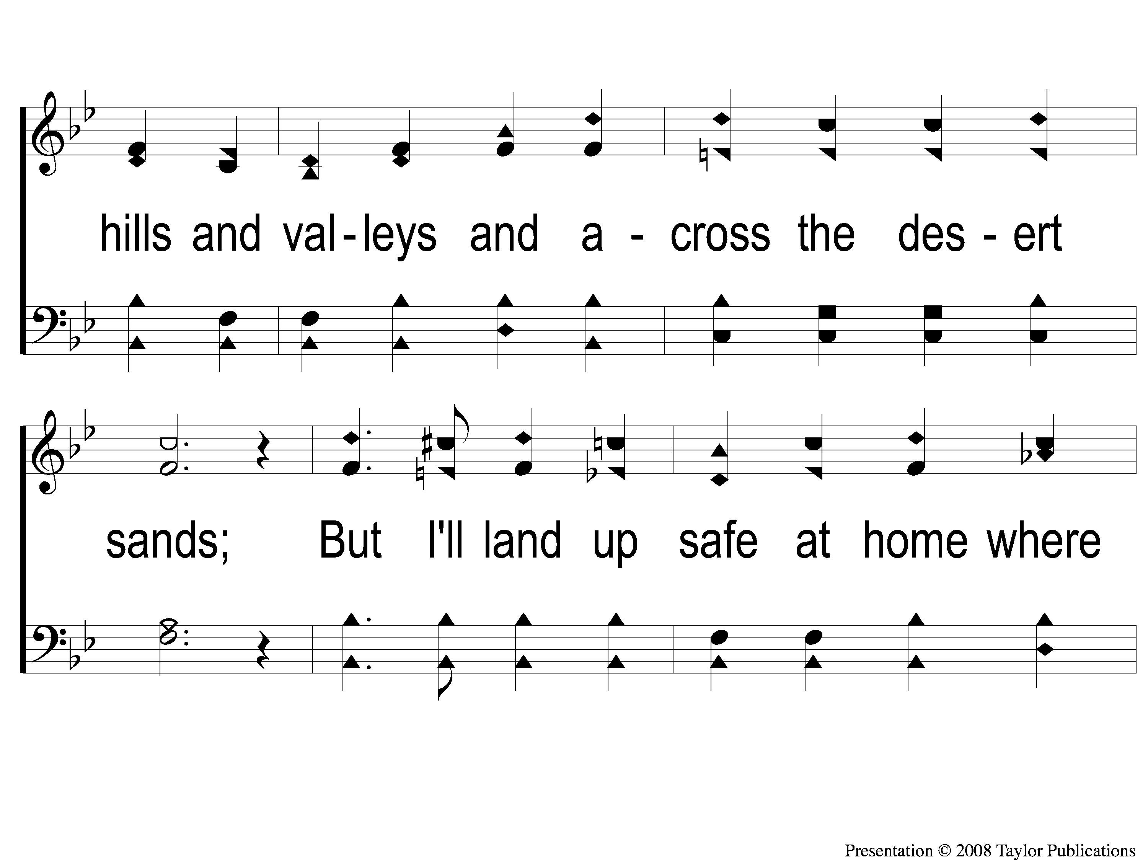
2-2 Camping Toward Canaan’s Land
Camping Toward Canaan’ Land
58

Slide 9
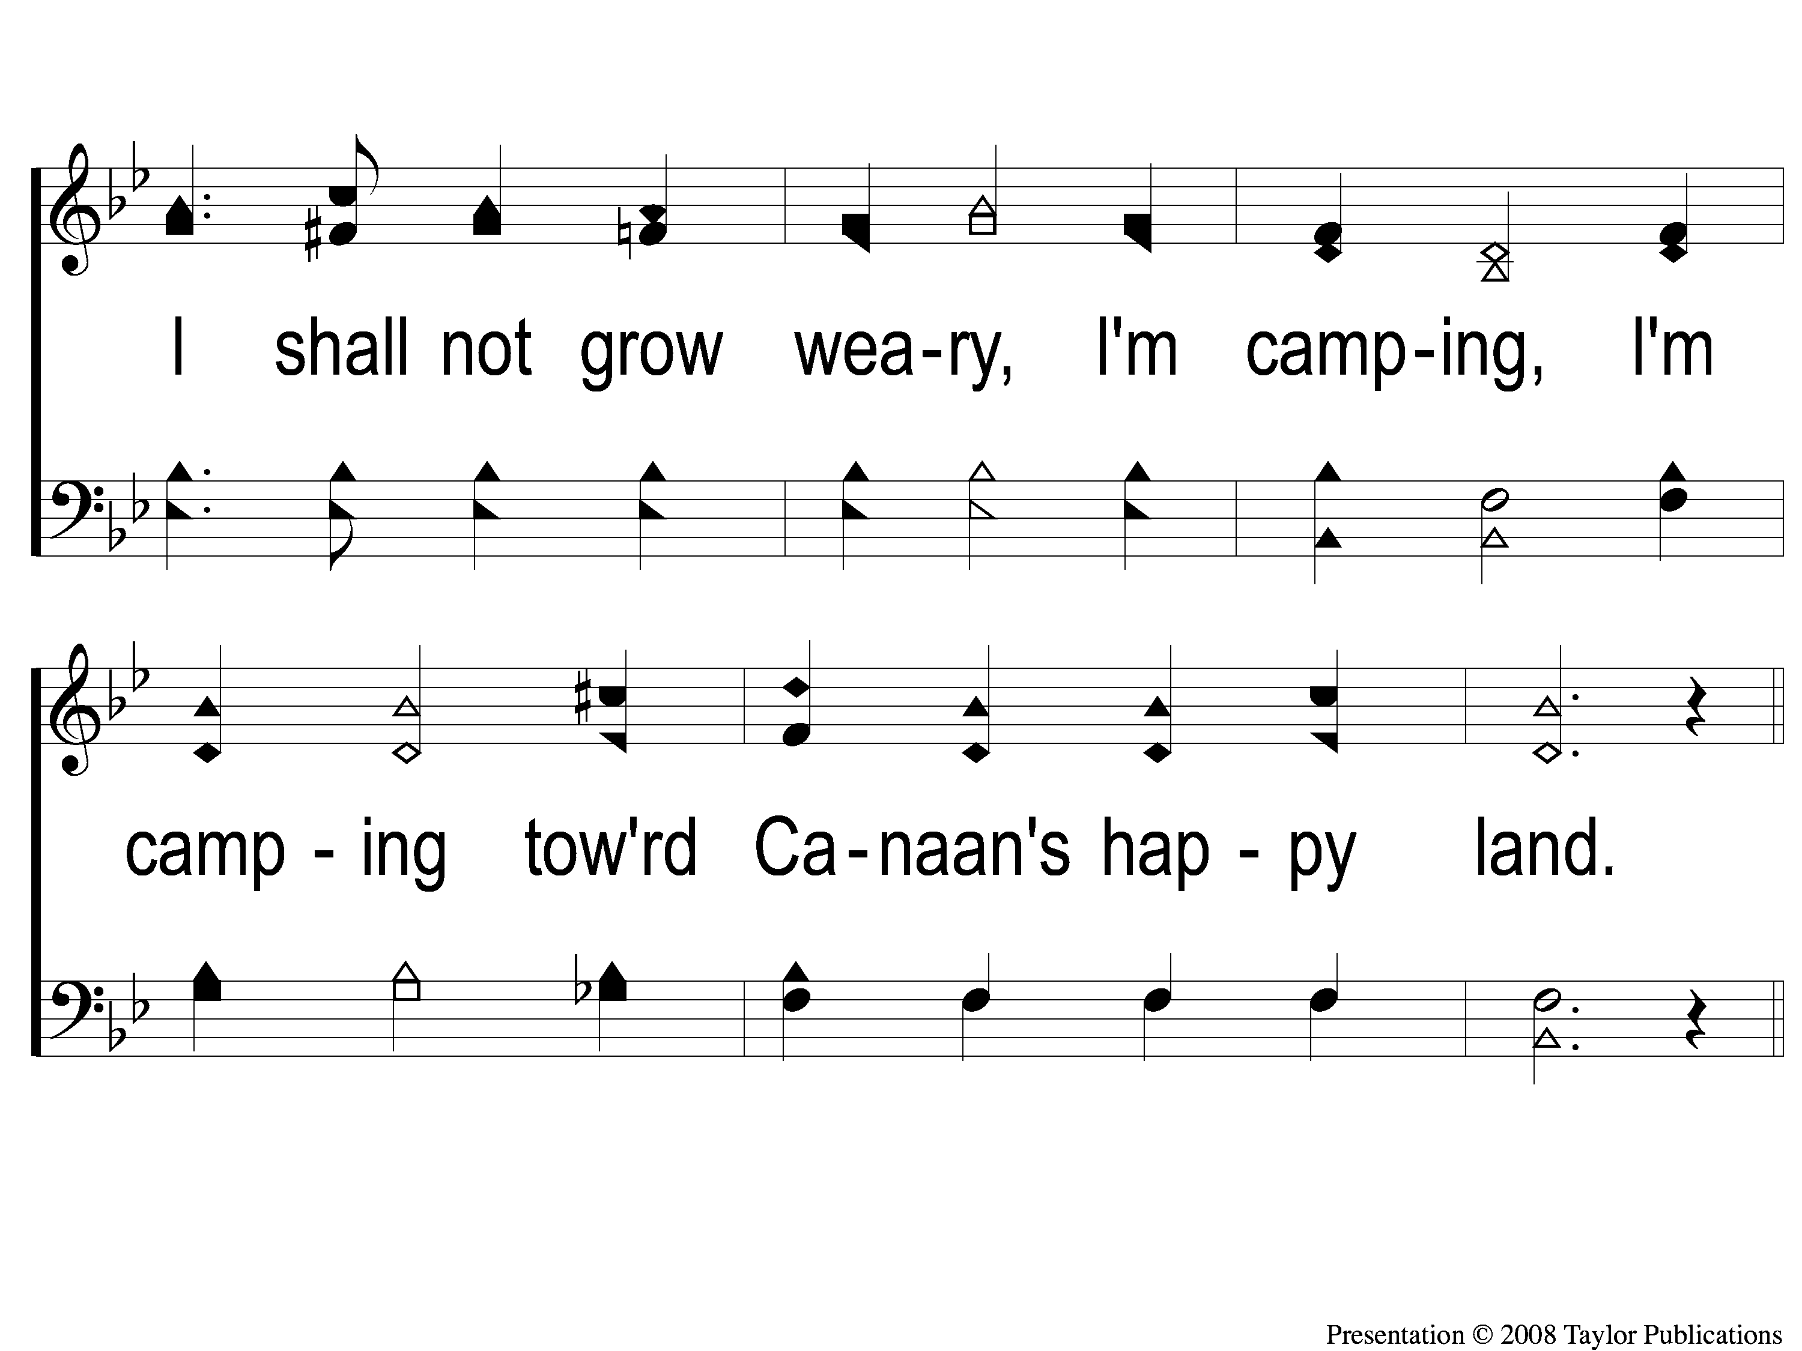
2-3 Camping Toward Canaan’s Land
Camping Toward Canaan’ Land
58

Slide 10
C-1 Camping Toward Canaan’s Land
Camping Toward Canaan’ Land
58

Slide 11
C-2 Camping Toward Canaan’s Land
Camping Toward Canaan’ Land
58

Slide 12
C-3 Camping Toward Canaan’s Land
Camping Toward Canaan’ Land
58

Slide 13
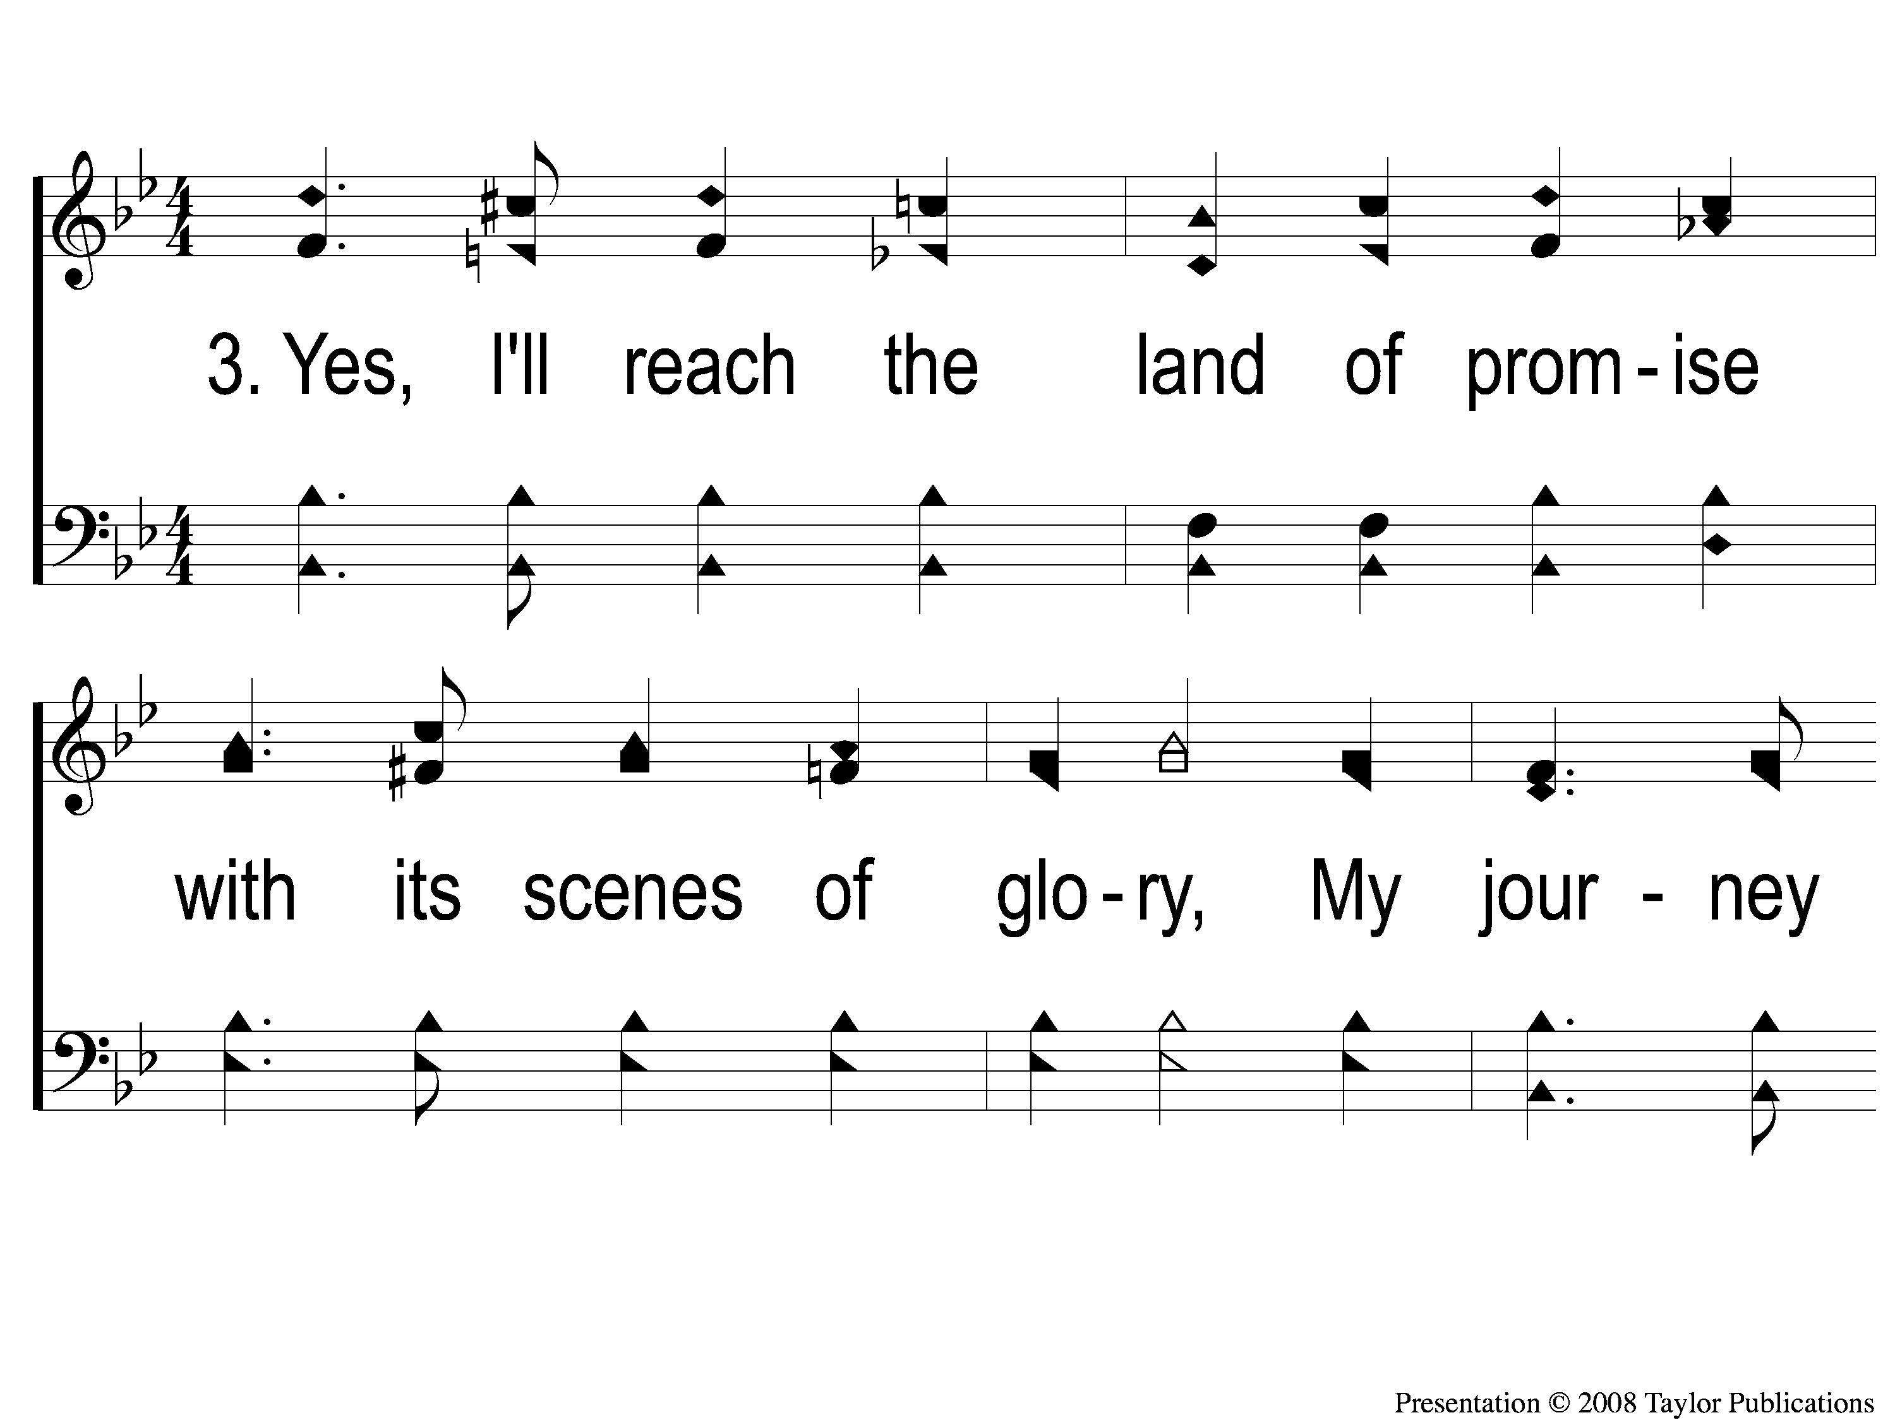
3-1 Camping Toward Canaan’s Land
Camping Toward Canaan’ Land
58

Slide 14
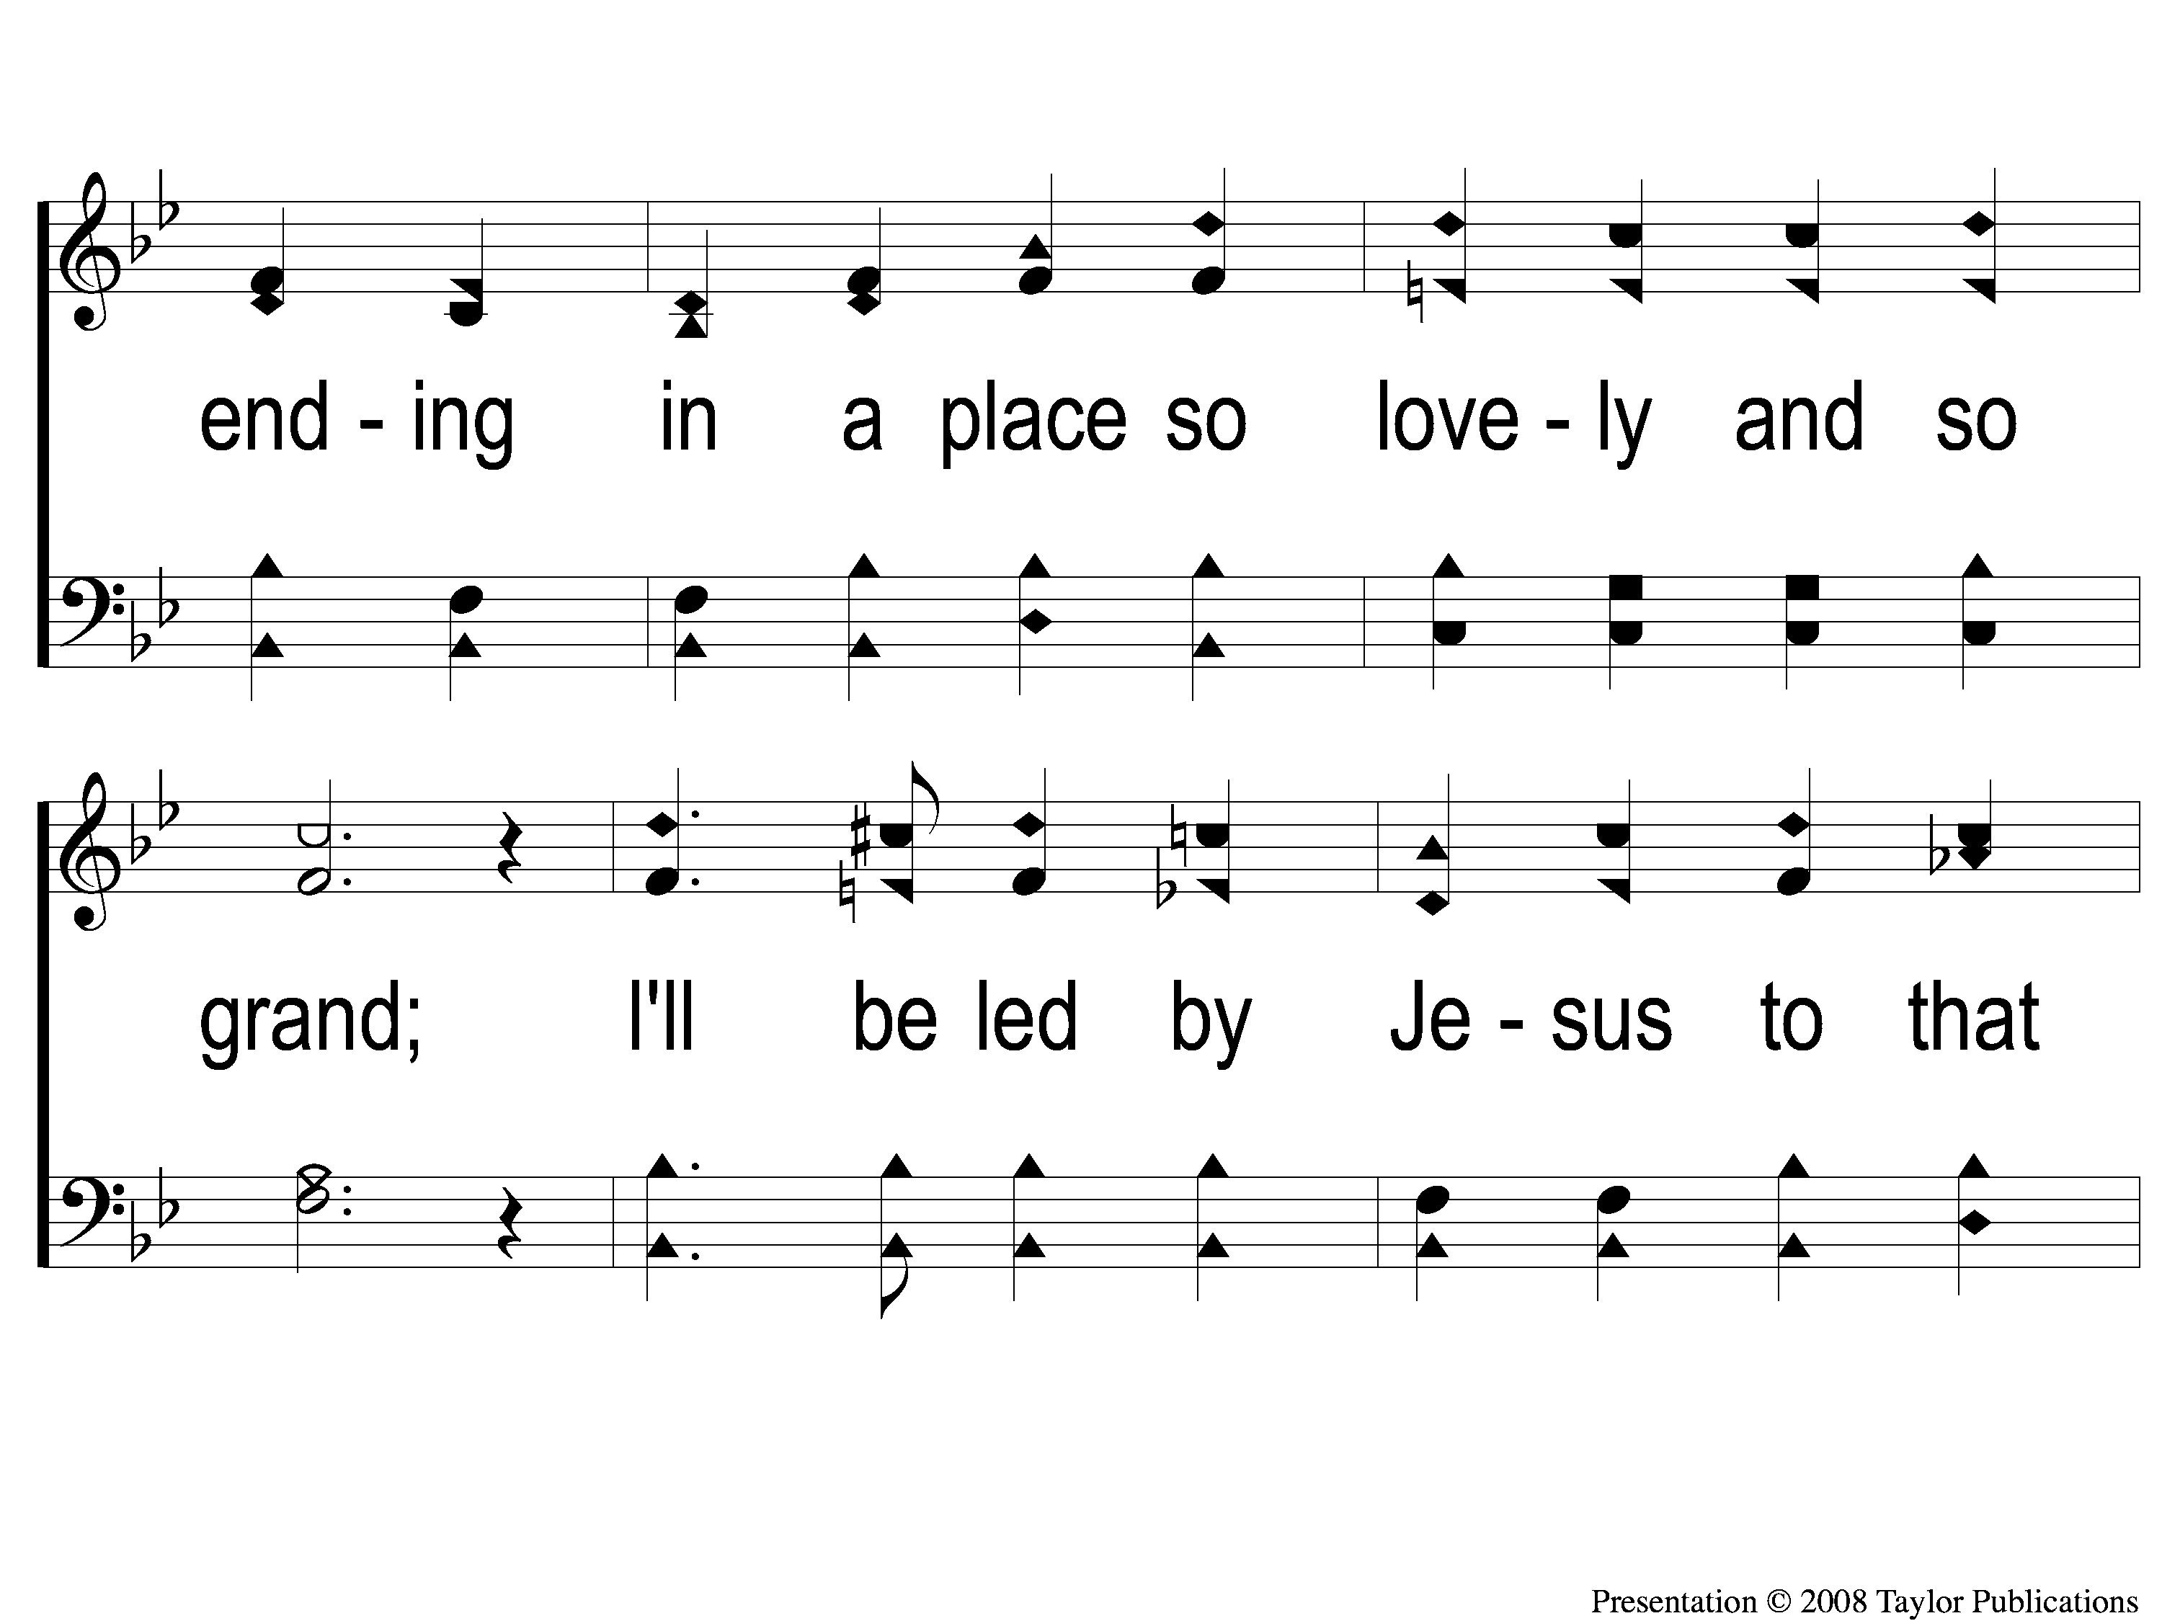
3-2 Camping Toward Canaan’s Land
Camping Toward Canaan’ Land
58

Slide 15
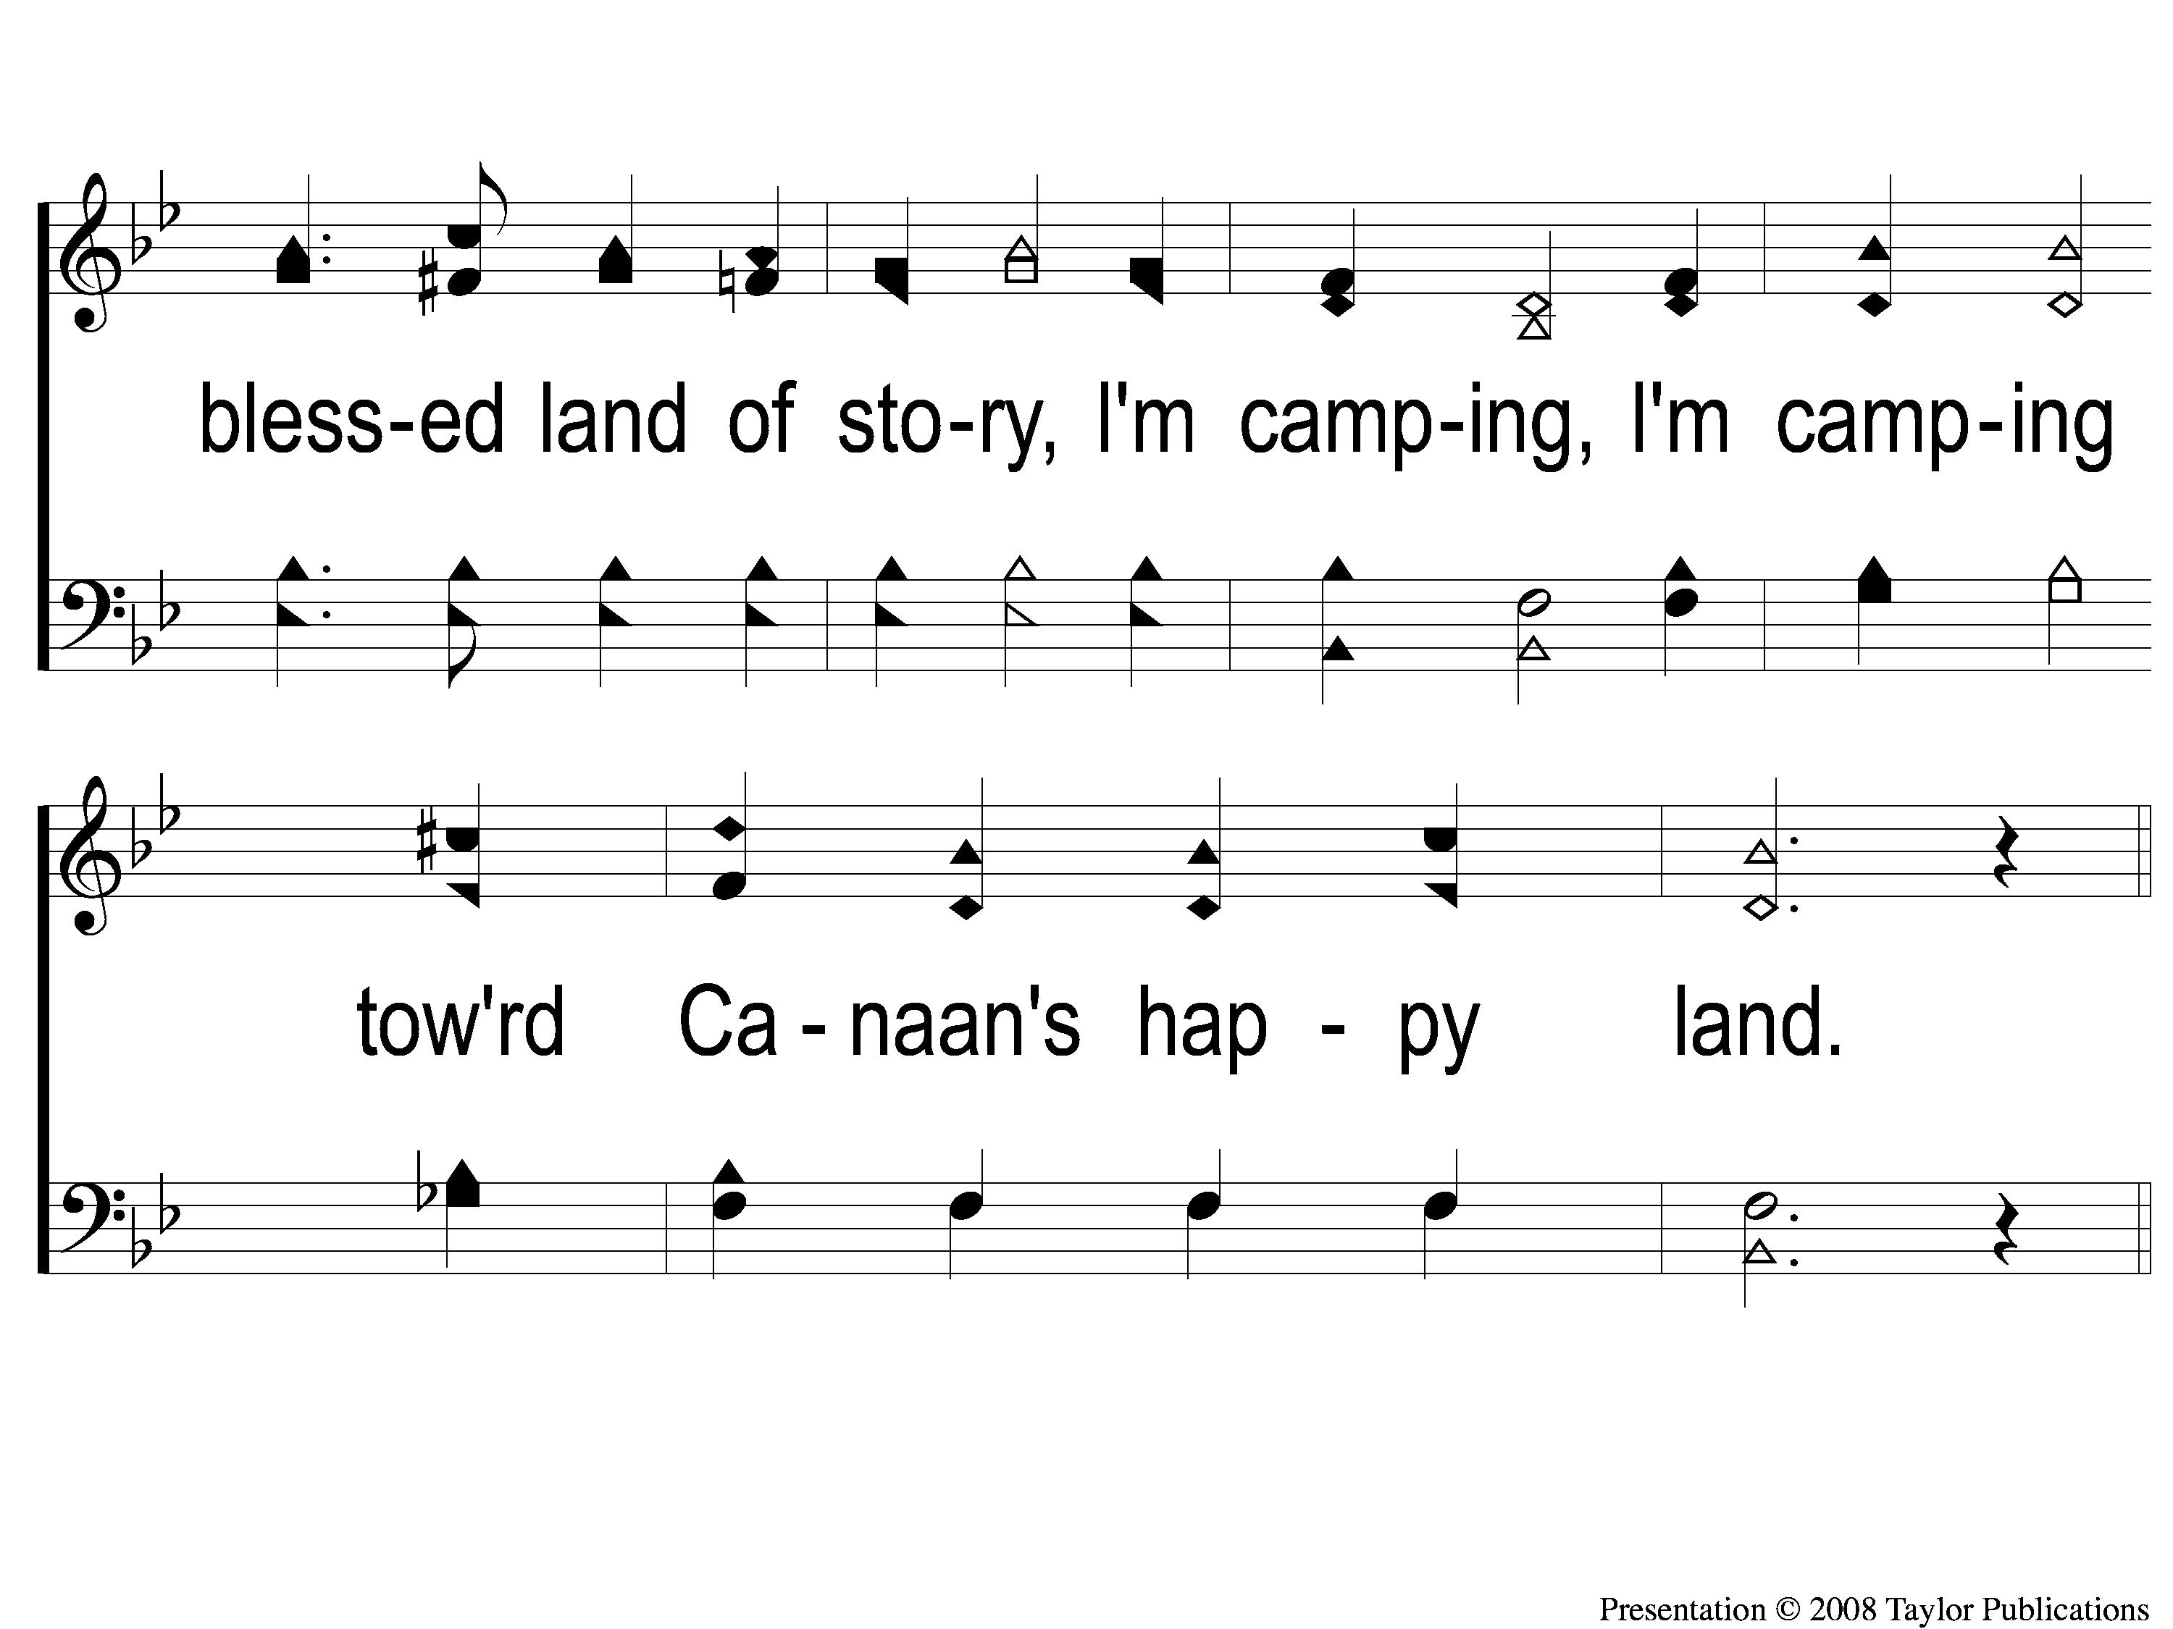
3-3 Camping Toward Canaan’s Land
Camping Toward Canaan’ Land
58

Slide 16
C-1 Camping Toward Canaan’s Land
Camping Toward Canaan’ Land
58

Slide 17
C-2 Camping Toward Canaan’s Land
Camping Toward Canaan’ Land
58

Slide 18
C-3 Camping Toward Canaan’s Land
Camping Toward Canaan’ Land
58

